Slide 1


Slide 2



Tanvir Ahmed Khan
Beta Microsoft Learn Student Ambassador
Competitive Programmer, Academic Mentor,
Programmer Lead @IIEC, Blockchain Enthusiast, CSE Senior
International University of Business Agriculture and Technology

Slide 3
Contents
Discussion about various International Programs
Microsoft Learn Student Ambassador
Postman Student Leader
AWS Cloud Captain
Perks and Benefits
Application Process
QNA Session & Gifts

Slide 4
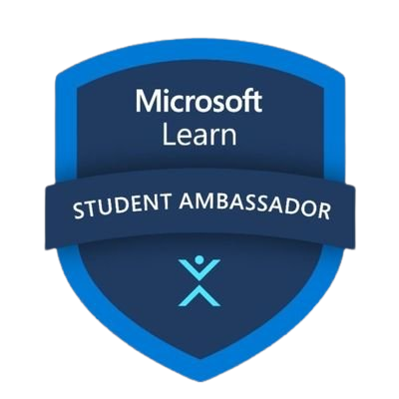
Microsoft Learn Student Ambassadors - MLSA
The Microsoft Learn Student Ambassadors program is a global group of on-campus ambassadors who are eager to –
Help students and their communities,
Lead in their local tech circles,
Develop technical and career skills for the future,
Organizing a campus or community hackathon,
Mentoring other students etc.

Slide 5
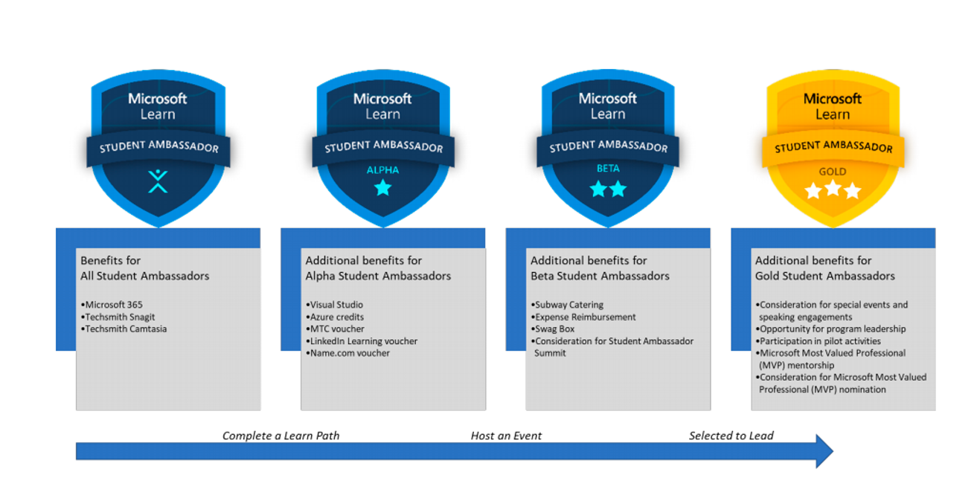
Milestones in MLSA

Slide 6
Milestones in MLSA
ALPHA - Student Ambassadors that complete a learning path on Microsoft Learn will earn the Alpha Badge
Benefits:
USD-150$ monthly Azure credits
Visual Studio Enterprise Subscription (With various products keys)
StudentAmbassadors.com email address
LinkedIn Learning Voucher
Name.com Voucher

Slide 7
Milestones in MLSA
BETA - Student Ambassadors who plan and host an event for other students in their community will earn the Beta badge.
Benefits:
Alpha benefits
Event support
Mentorship
MTC exam voucher
LinkedIn Premium or X-Box 360
Swag – [ Box containing multiple gifts ]

Slide 8
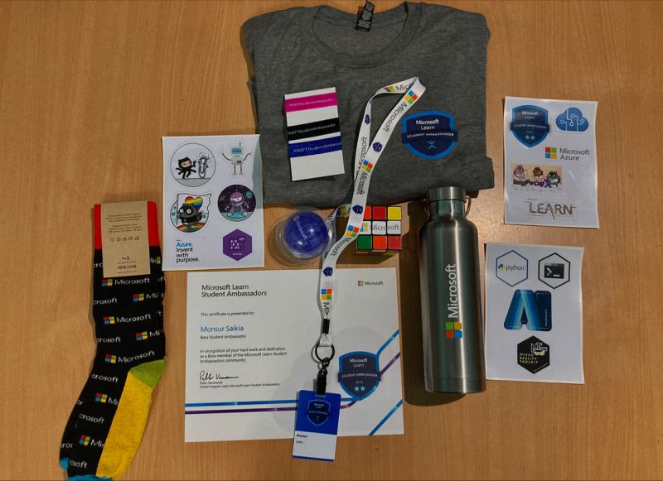
Milestones in MLSA
BETA SWAG KIT

Slide 9
Milestones in MLSA
GOLD - Student Ambassadors who have gone above and beyond serving their local community will be invited to the Gold Milestone.
Benefits:
Alpha and Beta benefits
Program leadership opportunities
Participate in pilot programs
Microsoft (MVP) mentorship
Consideration for the MVP program
Exclusive Gold swag
[Microsoft’s Most Valuable Professionals - MVP]

Slide 10
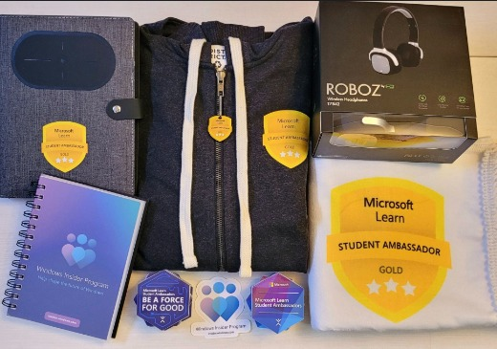
Milestones in MLSA
GOLD SWAG KIT

Slide 11
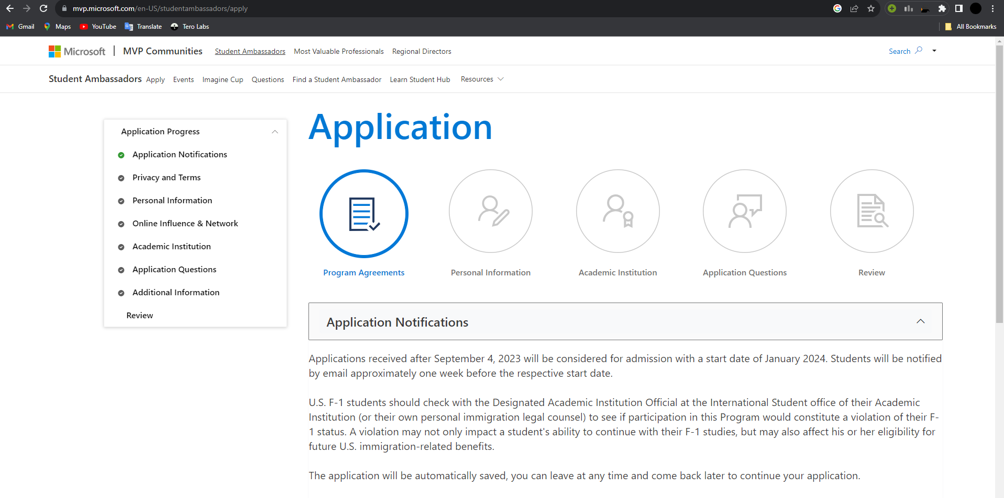
How to apply
Goto - https://mvp.microsoft.com/

Slide 12
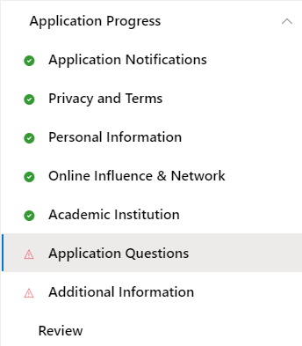

Slide 13
How to apply – Application Questions
Three questions - [2000 characters for writing and 2 minutes for video]
Guide
We are looking for students who are driven to guide their peers in learning technical skills. Tell us about one specific technical skill you have learned, and how you were guided to learning it. How would you use that experience to be a better Student Ambassador?
Connect
We are looking for students who have strong community ties and want to connect their communities to their peers. Tell us about a specific event you have planned that connected diverse audiences together. How would you use that experience to be a better Student Ambassador?
Welcome
We are looking for students who can provide an inclusive, accessible, and authentic environment to learn. Tell us about a specific time you welcomed a new person into one of your communities. How would you use that experience to be a better Student Ambassador?

Slide 14
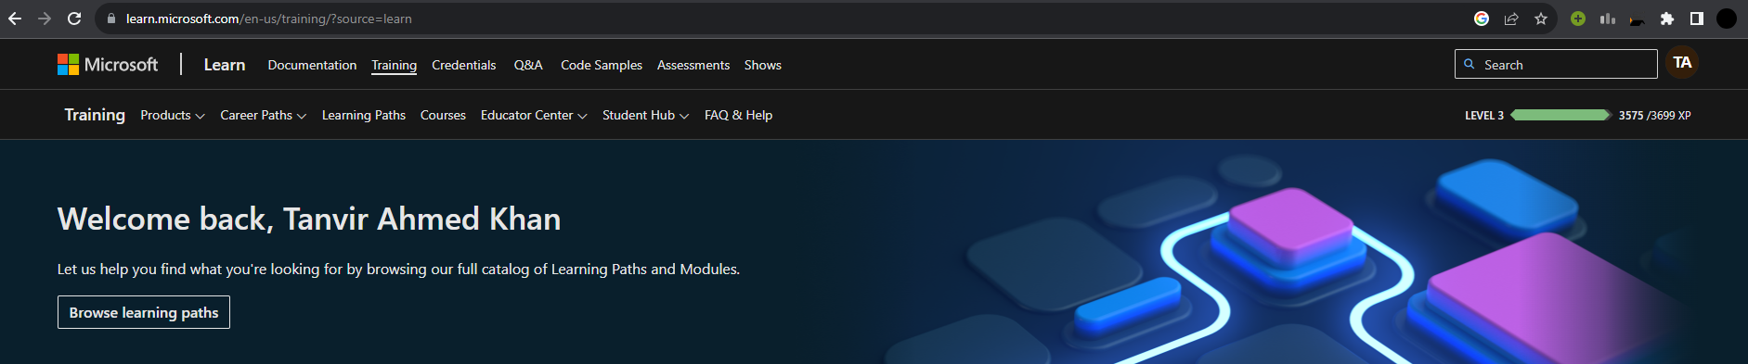
How to apply – Additional Information
If you have a Microsoft Learn profile, please share the link to your profile here, so we can see what you've been learning. Use this space to tell us about your involvement in your community, both online and on campus, and any organizations you're involved in, especially if you hold leadership positions. Feel free to share anything else you'd like us to know here as well.
Character limit - 10000

Slide 15
How to apply – Review
Microsoft reviews the application quarterly, (January, April, June, September). Students will be notified by email approximately one week before the respective start date.
The application will be automatically saved, you can leave at any time and come back later to continue your application.

Slide 16
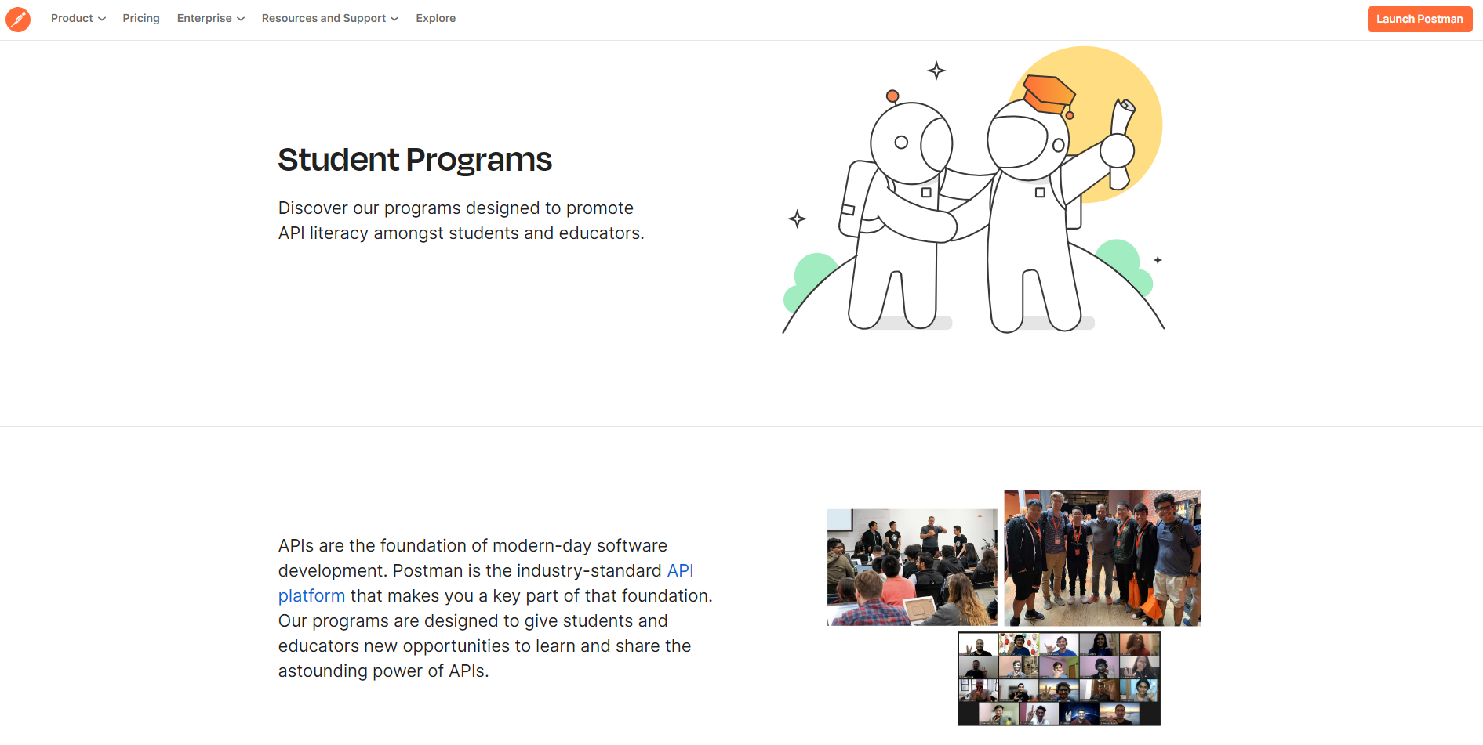

Postman Student Programs

Slide 17
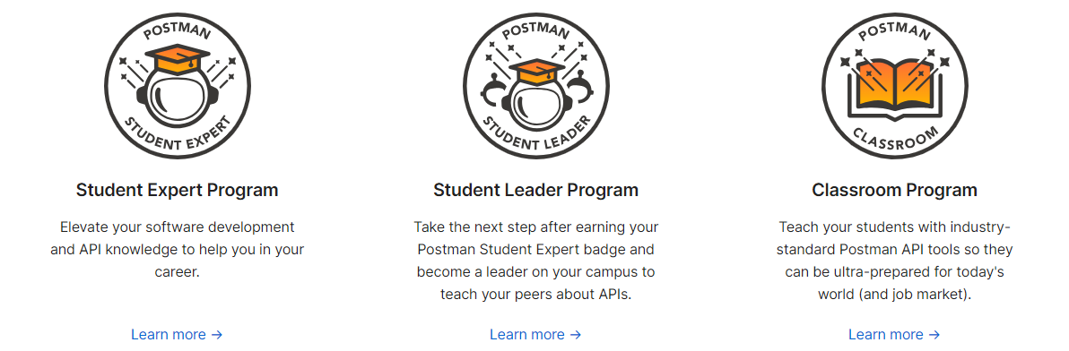
Programs for Postman

Slide 18
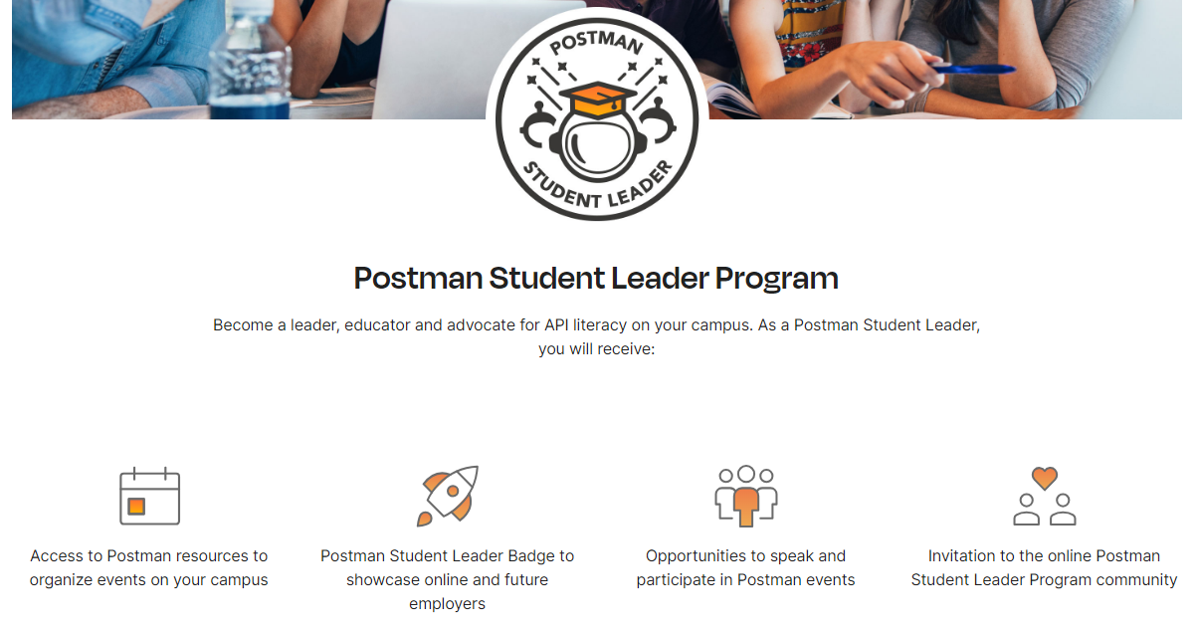
Benefits - Postman Student Leader Programs

Slide 19
Benefits - Postman Student Leader Programs
Access to Postman resources to organize events on their campus.
Postman Student Leader Badge.
Opportunities to speak and participate in Postman events.
Invitation to the online Postman Student Leader Program community.

Slide 20
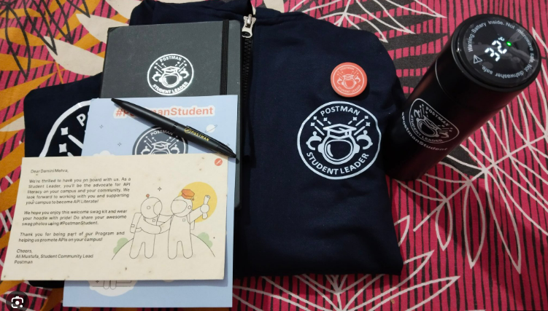
Postman Swag Kit

Slide 21
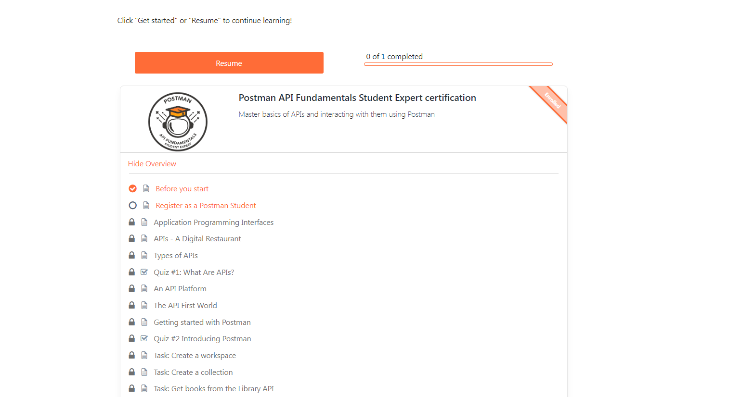
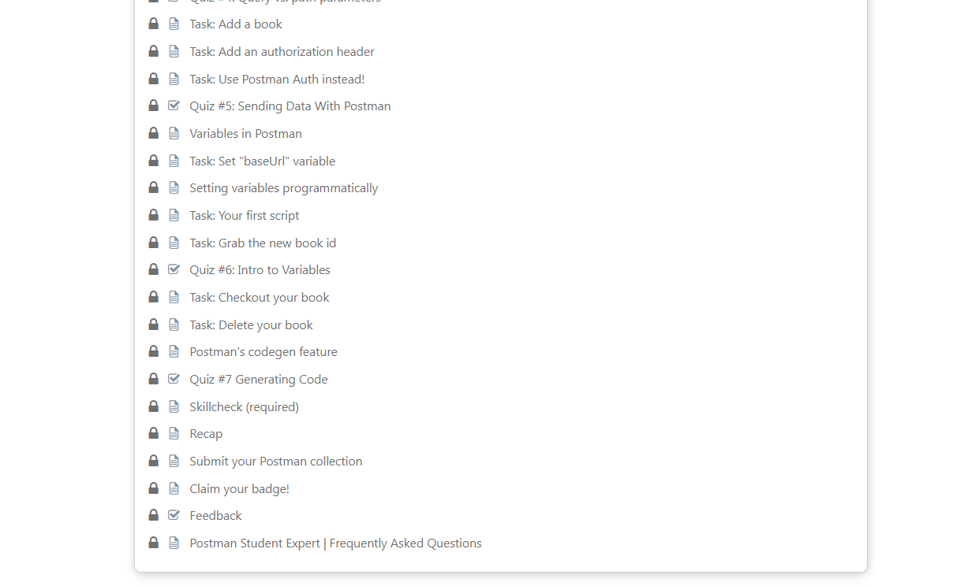
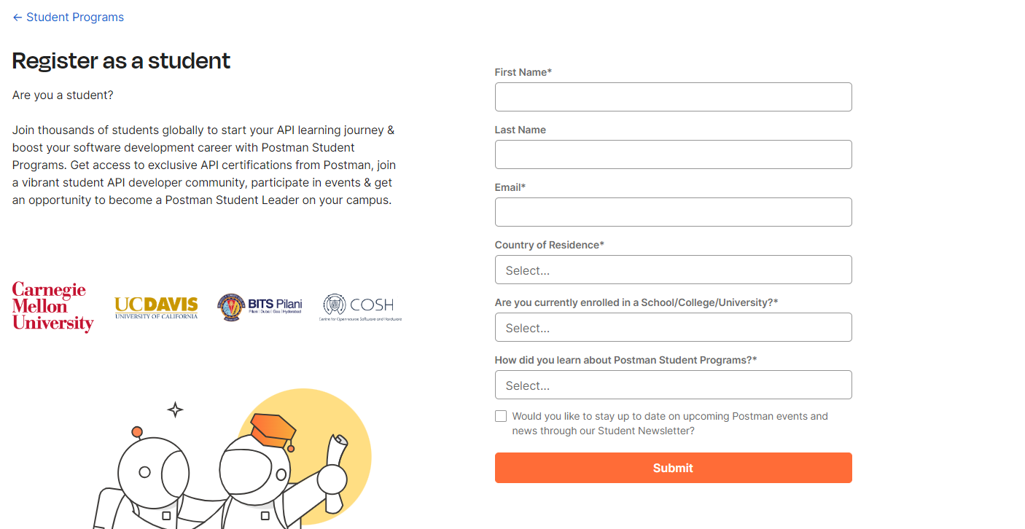
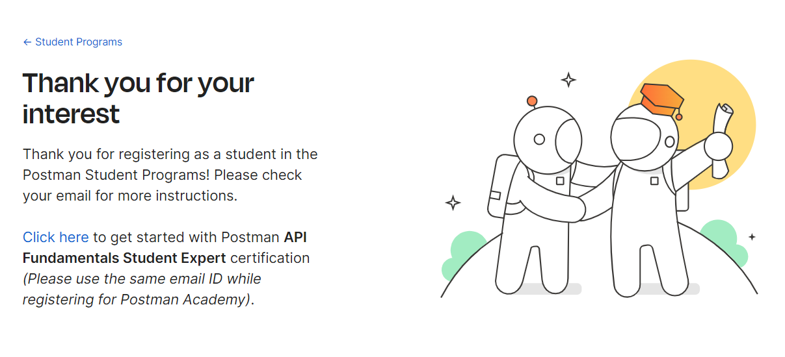
Application Process for Student Expert
Goto - www.postman.com/student-program/

Slide 22
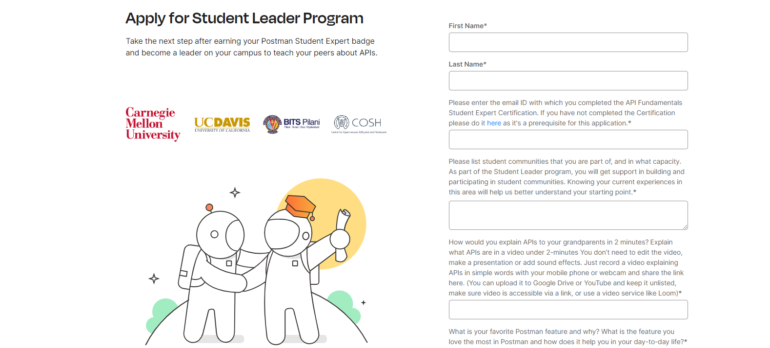
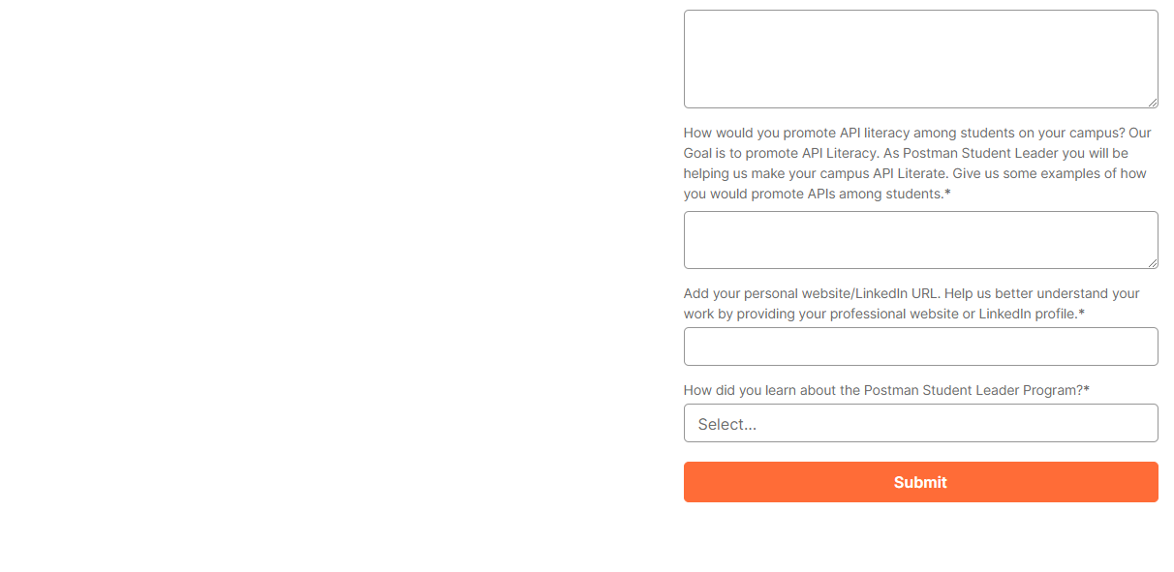
Application Process for Student Leader
Goto - www.postman.com/student-program/student-leader/

Slide 23
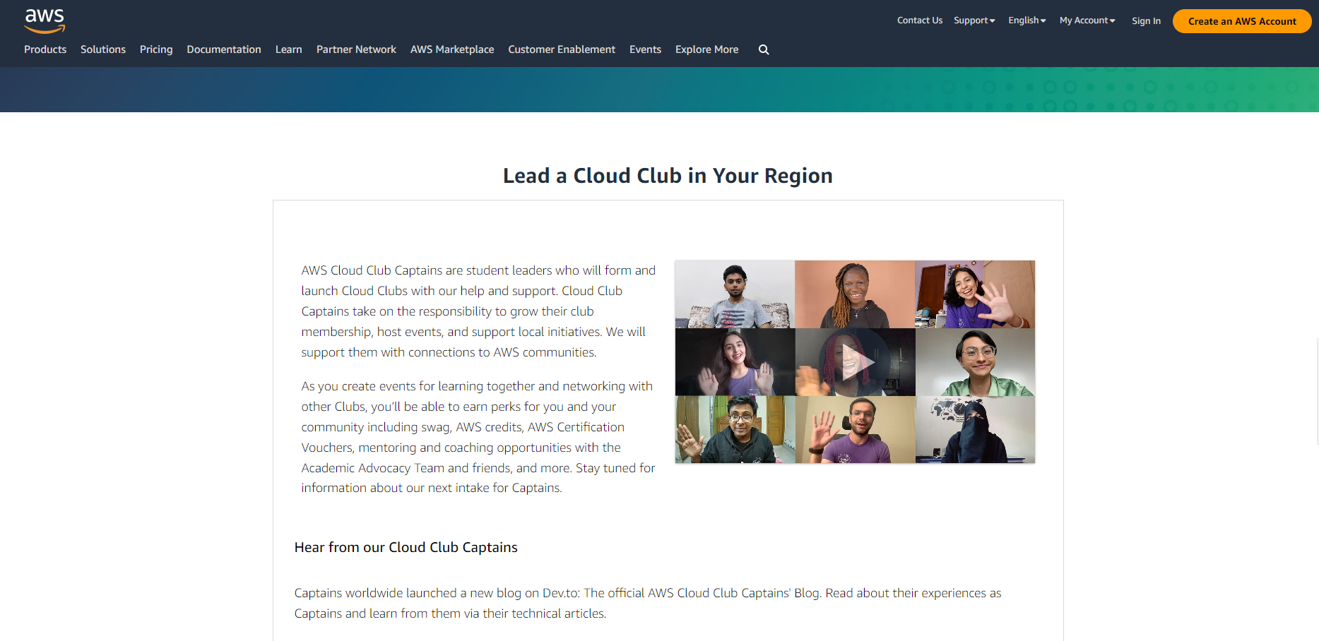

AWS Cloud Captain

Slide 24
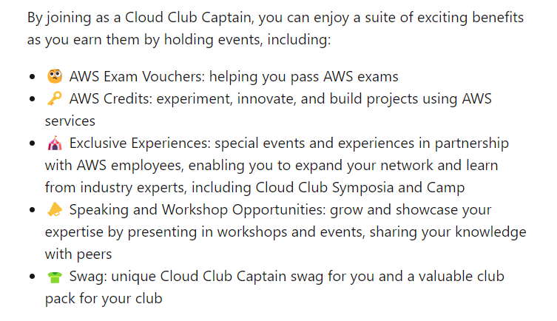
Benefits

Slide 25
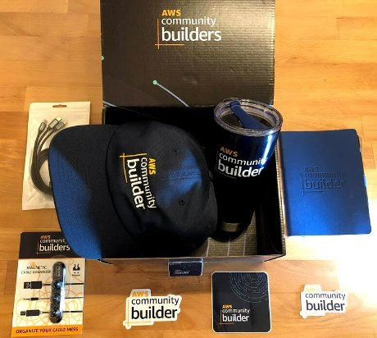
AWS Swag Kit

Slide 26
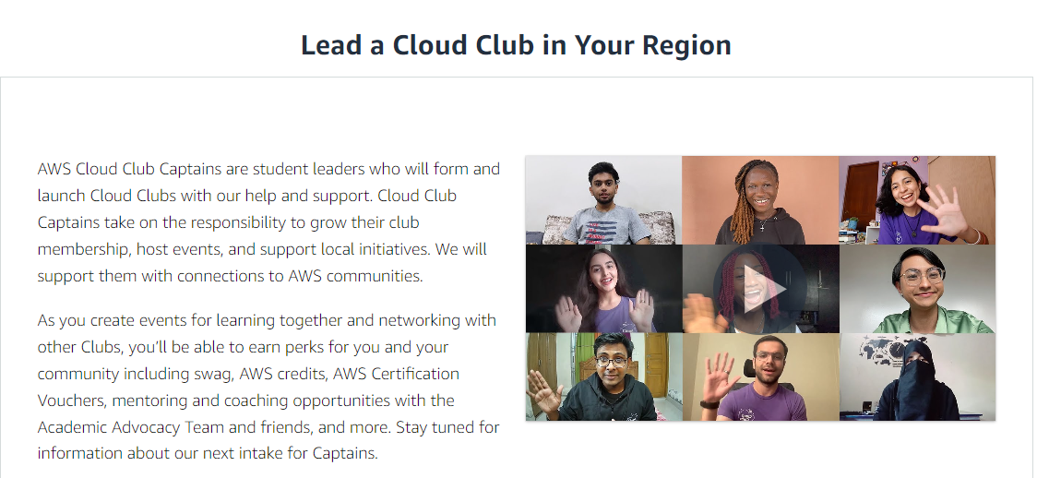
AWS Cloud Captain – BD Community

Slide 27
Pre-requisite to be AWS Cloud Captain
Must be a part of AWS Could Community
- Learn AWS cloud
- Form up a team (Minimum of 5)
- Make a good project
- Showcase it to the AWS cloud BD community
- Do some collaboration projects with BD community
- Finally we will be permitted to open the community
- Apply for the Cloud Captain

Slide 28


Slide 29
Question : 1
What is the URL/Link for applying in Microsoft Learn Student Ambassadors?
mvp.microsoft.com
mlsa.microsoft.com
msvp.microsoft.com

Slide 30
Question : 2
What is the highest milestone in Microsoft Learn Student Ambassadors?
Beta
Gold
Alpha

Slide 31
Question : 3
Which of the following programs prerequisite is a community?
MLSA
ASW Cloud Captain
Postman Student Leader

Slide 32
Question : 4
What is the first step of becoming Postman Student Leader?
Postman Classroom
Postman Student Leader
Postman Student Expert

Slide 33
Question : 5
Which of the following program may consider us as MVP?
MLSA
ASW Cloud Captain
Postman Student Leader

Slide 34
Activity -
Competitive Programming -
Contest – IUPC, ICPC(Regionals/World Finalist)
Development -
Hackathons – (Upcoming in IUBAT)
Cyber Security -
CTF - Catch The Flag
……………………..

Slide 35
Programming -
IUPC – Inter University Programming Contest
NCPC - National Collegiate Programming Contest (IUBAT Hosted in 2019)
ICPC – International Collegiate Programming Contest
ICPC – Regionals / World Finalist

Slide 36

Which of the following program may consider us as MVP?
Answer :
A. MLSA

